Slide 1



IIS 8 – Platform for the Future
Andrew Westgarth

Slide 2
Agenda
IIS State of the Union
ASP.Net Configuration Management
Application Initialization
Dynamic IP Restrictions
FTP Logon Attempt Restrictions
Sand-boxing Sites and Applications
SSL Scalability
Multi-core Scaling on NUMA Hardware
Web Sockets

Slide 3


Monkey Business
Technical Architect at Sage UK
ASP.Net Code Monkey
Co-founder of North East Bytes (@NEBytes)
User group for IT Pros and Devs in North East
@DDDNorth Founder and Organiser
Very Interested in Wartime exploits of 617 Squadron – the Dam Busters
Microsoft Most Valuable Professional for Internet Information Services (ASP.Net & IIS)
mail@hawaythelads.co.uk
Twitter.com/apwestgarth
www.andrewwestgarth.co.uk/blog

Slide 4
State of The Union
Version | Availability | Status
6.0 | Windows Server 2003/R2 | Extended Support
7.0 | Windows Vista/Windows Server 2008 | Mainstream Support
IIS Express 7.0 | Windows XP/Vista/7 | Mainstream Support
7.5 | Windows 7/Windows Server 2008 R2 | Mainstream Support
IIS Express 7.5 | Windows XP/Vista/7 | Mainstream Support
8.0 | Windows 8/Windows Server 2012 | RTM/GA
IIS Express 8.0 | Vista/7/8 | RTW

Slide 5

Web Platform Investments
Definition
WebFarmFramework
AppGallery
Operations
WebPI
Solutions delivered at a rapid place with many out of band releases
More than a dozen IIS Extensions have shipped since IIS 7.0
SEO
AdminPack
Design
Application
Life-Cycle
URLRewrite
ARR
Deployment
WebDeploy
Development
WebMatrix
Testing
Visual Studio
IIS Express
Notes:
Taken from //BUILD Session – IIS Sand-boxing and Scalability for Hosting on Modern Hardware - http://channel9.msdn.com/events/BUILD/BUILD2011/SAC-819T

Slide 6
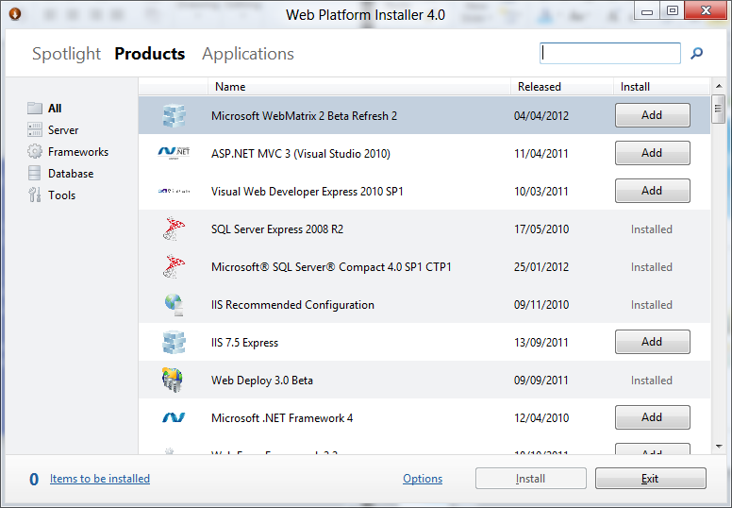
Web Platform Installer
Discover
Automate installation of Stacks and Apps
Works on all versions of Windows

Slide 7
ASP.Net 3.5 and 4.5 on IIS8
3.5 not installed by default
ASP.Net Configuration Management Tooling Update for v4.5 on IIS8 only
New Modules - .Net Roles; .Net Users; Providers
.Net Compilation
Additional Hashing Algorithms for MachineKey
Support for Page and controls behaviours

Slide 8
ASP.Net 3.5 and 4.5 - Demo

Slide 9
Configuration Improvements
+3.5x
Less memory than R2!
5.000 sites typical hosting config
WS08 R2 – Config mem usage: 1,400MB
WS8 – Config mem usage: 402MB
166x
faster
Notes:
Taken from //BUILD Session – IIS Sand-boxing and Scalability for Hosting on Modern Hardware - http://channel9.msdn.com/events/BUILD/BUILD2011/SAC-819T

Slide 10
Application Initialization - Problem
Administrators often need to perform initialization tasks
Warm up tasks
Prime in-memory caches
Generate content
First response impacts User

Slide 11
Application Initialization - Demo

Slide 12
Application Initialization Schema
<sectionSchema name="system.webServer/applicationInitialization">
<attribute name="remapManagedRequestsTo" type="string“ defaultValue="" />
<attribute name="skipManagedModules" type="bool" defaultValue="false" />
<attribute name="doAppInitAfterRestart" type="bool" defaultValue="false" />
<collection addElement="add" clearElement="clear" removeElement="remove" mergeElement="false">
<attribute name="initializationPage" type="string" required="true" isUniqueKey="true" />
<attribute name="hostName" type="string" defaultValue="" />
</collection>
</sectionSchema>

Slide 13
Application Initialization
SERVER VARIABLES
APP_WARMING_UP
SKIP_MANAGED_MODULES
WARMUP_REQUEST
PRELOAD_REQUEST
User Agent Strings
IIS Application Initialization Preload
IIS Application Initialization Warmup

Slide 14
Application Initialization - Solution
Module which enables Administrators to
Pro-Actively perform initialization tasks for one or more applications
Can configure IIS to return a splash page as a place holder until an application has initialized
Integrates with URL Rewrite module to support more complex handling of placeholder content.

Slide 15
Application Preload
Allows an application to be initialized when the IIS Worker Process Starts
Decide which applications should be preloaded
New process and recycled process behave differently

Slide 16
Application Pool Start Mode
Not new has been available in IIS 7.5 for a while
Setting on Application Pool
More beneficial along with Application Initialization

Slide 17
Dynamic IP Restrictions - Problem
Managing IP Restrictions is currently a high maintenance, laborious task
HTTP Clients would receive HTTP Error – 403.6 Forbidden
Maintain list of individual addresses
Log file analysis can be time consuming

Slide 18
Dynamic IP Restrictions - Demo

Slide 19
Dynamic IP Restrictions - Solution
Dynamic IP Address Filtering
Allows Admins to specify the blocking behaviour
Abort requests instead of returning error codes
Includes Proxy Mode

Slide 20
FTP Logon Restrictions - Problem
Possible Vulnerability
Brute Force Password Attack
Physical accounts used are primarily Windows Accounts
IIS 7 (With FTP7) and IIS 7.5 provided some mitigation
Extensibility API to create custom Authentication Providers

Slide 21
FTP Logon Restrictions – Demo

Slide 22
FTP Logon Restrictions - Solution
Built in network security provides functionality to prevent Brute Force Attacks without having to create a Custom Authentication Provider
Note – Server-level settings, cannot set per site as the attackers are trying to gain access to server not a single site.

Slide 23
Sand-boxing Sites and Applications - Problem
In multi-tenant environments need to provide Sand-boxed environments
Maintain level of service and availability
Prevent impact on other sites/tenants

Slide 24
Sand-boxing Sites and Applications - Demo

Slide 25
Sand-boxing Sites and Applications - Solution
Sand-box scoped to Application Pool
Process level security and resource limitations
Achieved by running each tenant under separate user identity
CPU Throttling feature
Limit how much each tenant can consume, can be set per tenant
IMPORTANT: CPU Throttling is not a reservation of CPU Resource rather is a LIMIT of maximum usage

Slide 26
SSL Scalability - Problem
More and more e-commerce sites coming online
More businesses sharing sensitive data online
Challenges
SSL Scalability
IPv4 Scalability
SSL Manageability

Slide 27
SSL Scalability - Demo

Slide 28
SSL Scalability - Solution
Server Name Indication (SNI)
TLS extension which includes virtual domain as part of SSL negotiation
NOTE: Client browsers need to be able to support SNI. Most modern browser provide support
BUT no version of IE on Windows XP supports SNI
Centralized SSL Certificate Support

Slide 29
Multicore Scaling on NUMA Hardware - Problem
Generally speaking increased hardware in the form of more cores should result in increased performance.
-20% from 32 cores
Notes:
Basic commodity server in 2014:
16 to 64 logical cores.
NUMA architecture.
64GB RAM.
40Gbit NIC.
$300-$1500 w/o OS.
High end server:
256 or 512 logical cores.
Graph taken from //BUILD Session – IIS Sand-boxing and Scalability for Hosting on Modern Hardware - http://channel9.msdn.com/events/BUILD/BUILD2011/SAC-819T

Slide 30
Multicore Scaling on NUMA Hardware - Demo

Slide 31
Multicore Scaling on NUMA Hardware - Solution
IIS8 on Windows Server 8 is NUMA-aware providing the optimal configuration
Partition workload through
Run Multiple Worker Processes in one Application Pool (Web Garden)
Run Multiple Application pools in Single Workload/Site
Two methods of Affinitization
Soft Affinity (Default)
Hard Affinity

Slide 32
Web Sockets on IIS8
Server Support Out Of The Box
WCF 4.5 support for netHttpBinding
Supported in IIS Express 8 when using Windows 8

Slide 33
Conclusion and Questions?

Slide 34

Resources
What’s New in IIS 8.0 - http://bit.ly/LearnIIS8
Application Initialization – http://bit.ly/IISAppInit
Dynamic IP Restrictions - http://bit.ly/IISDynIPRest

